Slide 1
Alumni Hub
Name: Shubham Sanjay Sahane
Class : MCA-II
Roll No:106
Seat No: 1632

Slide 2
Introduction
Objective: Connect alumni of an educational institution for networking and information sharing.
Problem: Lack of a centralized platform for alumni engagement and easy access to institute-related information.
Solution: Alumni Hub provides a platform to connect, share experiences, and stay updated about events.
Features:
Alumni Profiles and Search
Contact with Teachers and Students
Event Postings and Job Opportunities
Photo Gallery and Scheduled Events
Arrange Sessions for Current Students
Alumni Job Postings for Career Support
Easy Access to Relevant Institute Information
Technology: Java-based web technologies - JSP, Servlets, and JDBC.
Benefits:
Encourages collaboration and support among alumni.
Boosts alumni engagement and participation in events.
Provides a sense of community among alumni and the institute.
Additional Features:
Alumni can arrange sessions for current students.
Alumni can post job vacancies to help current students.
Students can seek guidance from alumni.
Photo gallery and event scheduling features.

Slide 3
Scope of System
Comprehensive platform for alumni engagement and networking.
Connect alumni of the educational institution.
User-friendly and centralized platform.
Interact, share information, and stay connected.
Key components and functionalities:
Alumni Profile Creation and Search
Contact with Teachers and Current Students
Event and Job Postings
Gallery of Photos and Memories
Organize Sessions and Workshops
Tracking Session Participation
Newsletter Distribution
Admin Panel for User Management

Slide 4
Proposed System
Alumni Profile Creation: Personalized profiles with contact details, professional experience, and other relevant information, facilitating effective networking.
Searchable Alumni Directory: Enables targeted searches based on location, industry, skills, and profession for meaningful collaborations.
Contact with Teachers and Current Students: Seamless communication for knowledge exchange, mentorship, and appreciation.
Interaction with Current Students: Offers guidance, shares experiences, and supports the educational journey of current students.
Event and Job Postings: Posts and views upcoming events and job opportunities, promoting career growth and networking.
Gallery of Photos and Memories: Upload and share photos to strengthen the emotional bond between alumni and their alma mater.
Organize Sessions and Workshops: Alumni can host knowledge exchange sessions and invite participants.
Tracking Session Participation: Visibility into the list of participants in organized sessions fosters a sense of community.
Newsletter Distribution: Regular updates on institutional activities, alumni achievements, and events.
Admin Panel: Manage user accounts, monitor activities, and moderate content for smooth functioning and security.

Slide 5
Objective Of System
Enhanced Alumni Engagement: Create a centralized platform for networking and interaction, fostering a sense of community and belonging with the educational institution.
Facilitate Networking: Enable seamless networking among alumni through a searchable directory, promoting meaningful collaborations.
Promote Knowledge Exchange: Foster knowledge exchange, mentorship, and appreciation by facilitating alumni's interaction with current and retired teachers.
Support for Current Students: Provide guidance, share experiences, and offer valuable insights to support the educational journey of current students.
Event and Job Opportunities: Enable alumni to post and view upcoming events and job opportunities, promoting career growth and networking.
Memories and Nostalgia: Allow alumni to share photos and memories, fostering nostalgia and strengthening emotional bonds with their alma mater.
Knowledge Sharing Sessions: Empower alumni to organize sessions, workshops, or webinars, promoting knowledge sharing and skill development.
Timely Communication: Facilitate communication through newsletters containing updates on institutional activities and achievements.
Admin Management: Provide an admin panel for smooth user account management, system monitoring, and content moderation.
Enhanced Alumni-Teacher Relationship: Strengthen the bond between alumni and teachers through continued interaction and appreciation.
Professional Networking: Foster professional networking opportunities, enabling alumni to connect with peers in their industries.
Institutional Involvement: Encourage greater alumni participation in the institution's events and activities, strengthening their ties with the alma mater.
User-Friendly Interface: Design an intuitive and user-friendly interface for a seamless experience, regardless of technical proficiency.

Slide 6
Operating Environment-Hardware and Software
Server:
Operating System: Ubuntu 20.04 LTS
Web Server: Apache HTTP Server 2.4.41
Java Development Kit (JDK): OpenJDK 11
Java Servlet Container: Apache Tomcat 9.0.41
Database Management System: MySQL 5.7
Version Control System: Git 2.25.1
SSL Certificate: Let's Encrypt (latest version)
Email Server: Scala (SMTP Server)
Build Tools: Apache Maven 3.8.1
Client:
Web Browser: Any latest version (Chrome, Firefox, Safari, etc.)

Slide 7
Need Of System
Lack of a centralized platform for alumni to connect and stay engaged.
Inefficient reliance on social media and personal networks for communication.
Limited interaction between alumni and current students or teachers.
Absence of a centralized event and job posting mechanism.
No dedicated space for sharing photo galleries or arranging sessions.
Inefficient distribution of newsletters.

Slide 8
Users Of System
Admin:
Highest level of access and privileges.
Responsible for system management and oversight.
Manages user accounts and permissions.
Moderates content and monitors system performance.
Generates analytics and reports.
Handles system maintenance and updates.
Alumni:
Former students maintaining a connection with the institution.
Access to alumni directory and resources.
Engage with teachers and current students.
Participate in alumni events and sessions.
Share experiences and provide career guidance.
Contribute through donations and support.

Slide 9
Student:
Current students actively participating in learning activities.
Access to course sessions and event gallery.
Interact with alumni for mentorship and guidance.
Participate in alumni-organized sessions and events.
View job postings shared within the alumni community.
Teachers:
Responsible for instructing and guiding students.
Create and manage instructional materials.
Assess student progress and provide feedback.
Engage with alumni for mentorship and updates.
Participate in alumni-organized sessions and events.

Slide 10
Module Specification
Admin :
Add Student: Add new students to the student database.
Add Teacher: Add new teachers to the teacher database.
View Teacher Profile: Access and view teacher profiles and their details.
View Student Profile: Access and view student profiles and their details.
View Alumni: View a list of all alumni registered in the system.
Update Footer Content: Modify and update footer content on the system's pages.
Add Event: Create and add new events to the platform.
View Event: Access and view a list of all events organized by the institution.
Add Photos: Upload and add photos to the system's gallery.
View Photos: Access and view all the photos available in the system's gallery.
Edit Event: Edit event details such as date, time, and description.
Add Session: Create and schedule sessions or webinars for users.
View Session: Access and view all scheduled sessions and webinars.
Delete Session: Remove scheduled sessions from the system.
Delete Event: Delete events from the system.
Delete Photos: Remove photos from the gallery.
Delete Student: Delete student profiles from the system.
Delete Teacher: Delete teacher profiles from the system.
Add/Delete FAQs: Add or delete frequently asked questions from the system.
View Contact Us Requests: Access and view messages received via the "Contact Us" form.
Send Newsletter: Create and send newsletters to all registered users, including alumni, teachers, and students.
Generate Reports: Generate reports in various formats like CSV, Excel, PDF, or direct print.

Slide 11
Alumni:
Update Profile: Access and edit your personal and professional information.
Alumni Directory: Explore the directory to find and connect with other alumni based on location, industry, or profession.
Message Alumni: Send direct messages to fellow alumni through the system.
View Events: Access and view a list of upcoming events organized by the institution.
View Job Posts: Explore job postings shared by other alumni.
View Sessions: Enroll for sessions or webinars and leave joined sessions.
Chat Box: Interact with teachers, current students, and public chat groups.
Gallery: Access and view photos in the system's gallery.

Slide 12
Teacher:
Update Profile: Access and edit your personal and professional details.
Message Alumni: Send direct messages to alumni through the system.
Message Students: Send direct messages to students through the system.
View Events: Access and view a list of upcoming events organized by the institution.
View Job Posts: Explore job postings shared by alumni.
View Sessions: View scheduled sessions and arrange sessions for students.
Edit Session: Modify session details such as date, time, and description.
Delete Session: Remove scheduled sessions from the system.
View Participants: Access the list of participants in a session.
Chat Box: Interact with alumni, current students, and public chat groups.
Gallery: Access and view photos in the system's gallery.

Slide 13
Student :
Update Profile: Access and edit your personal and academic details.
Message Alumni: Send direct messages to alumni through the system.
View Events: Access and view a list of upcoming events organized by the institution.
View Job Posts: Explore job postings shared by alumni.
View Sessions: Enroll for sessions or webinars and leave joined sessions.
Chat Box: Interact with alumni, teachers, and public chat groups.
Gallery: Access and view photos in the system's gallery.

Slide 14
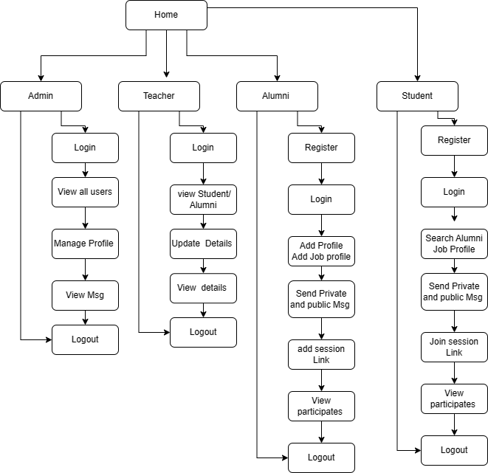
User Interface Screen

Slide 15
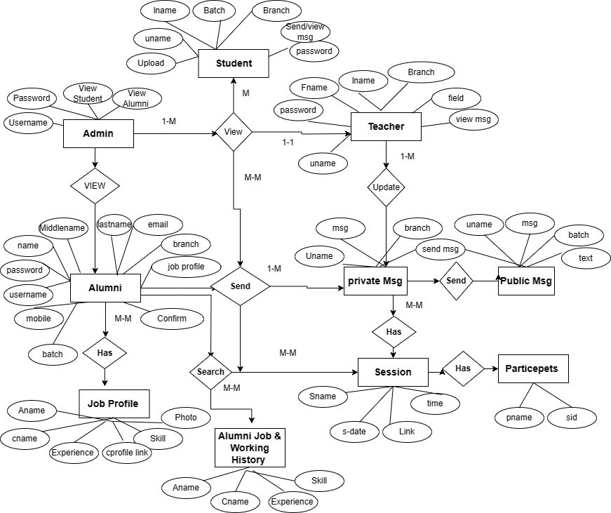
ERD

Slide 16
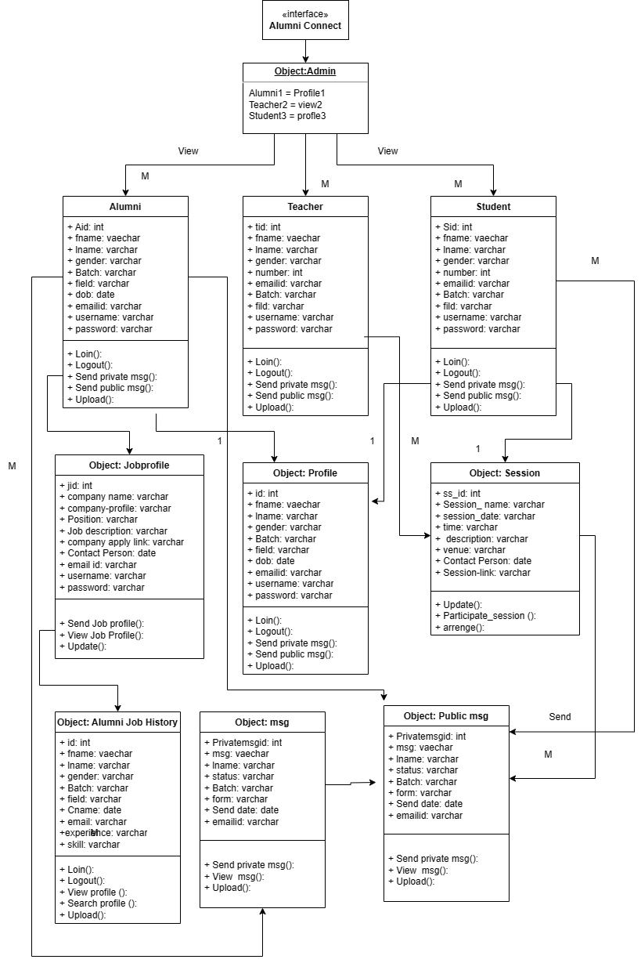
Object Diagram

Slide 17
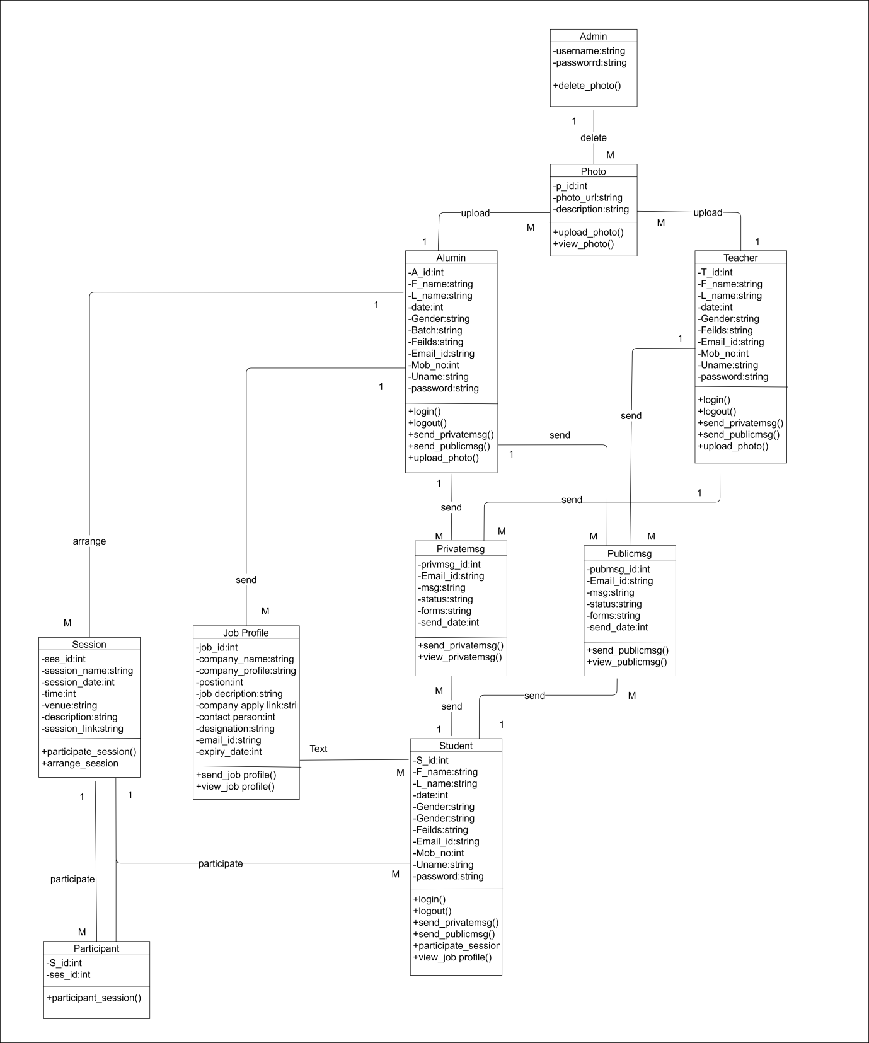
Class Diagram

Slide 18
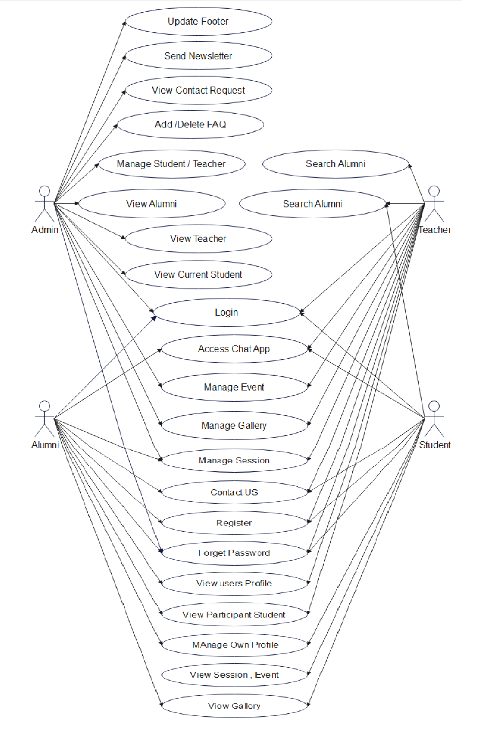
Use Case Diagram

Slide 19
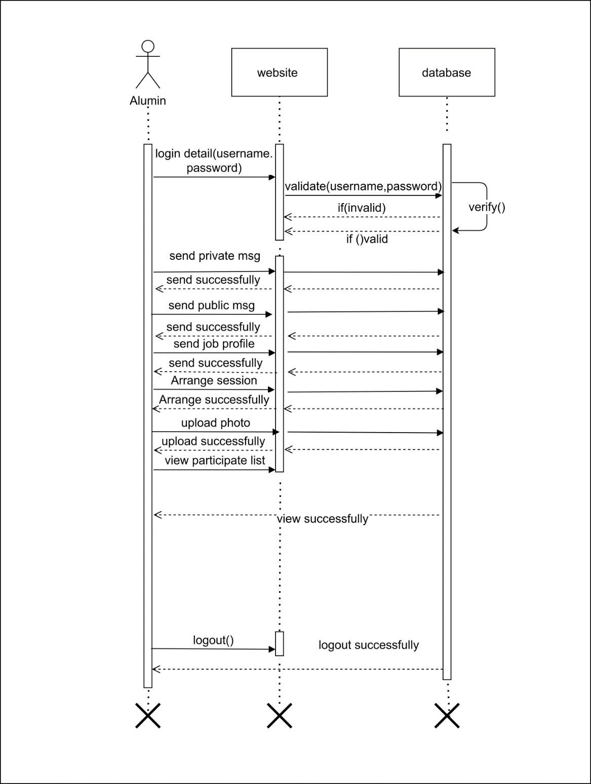
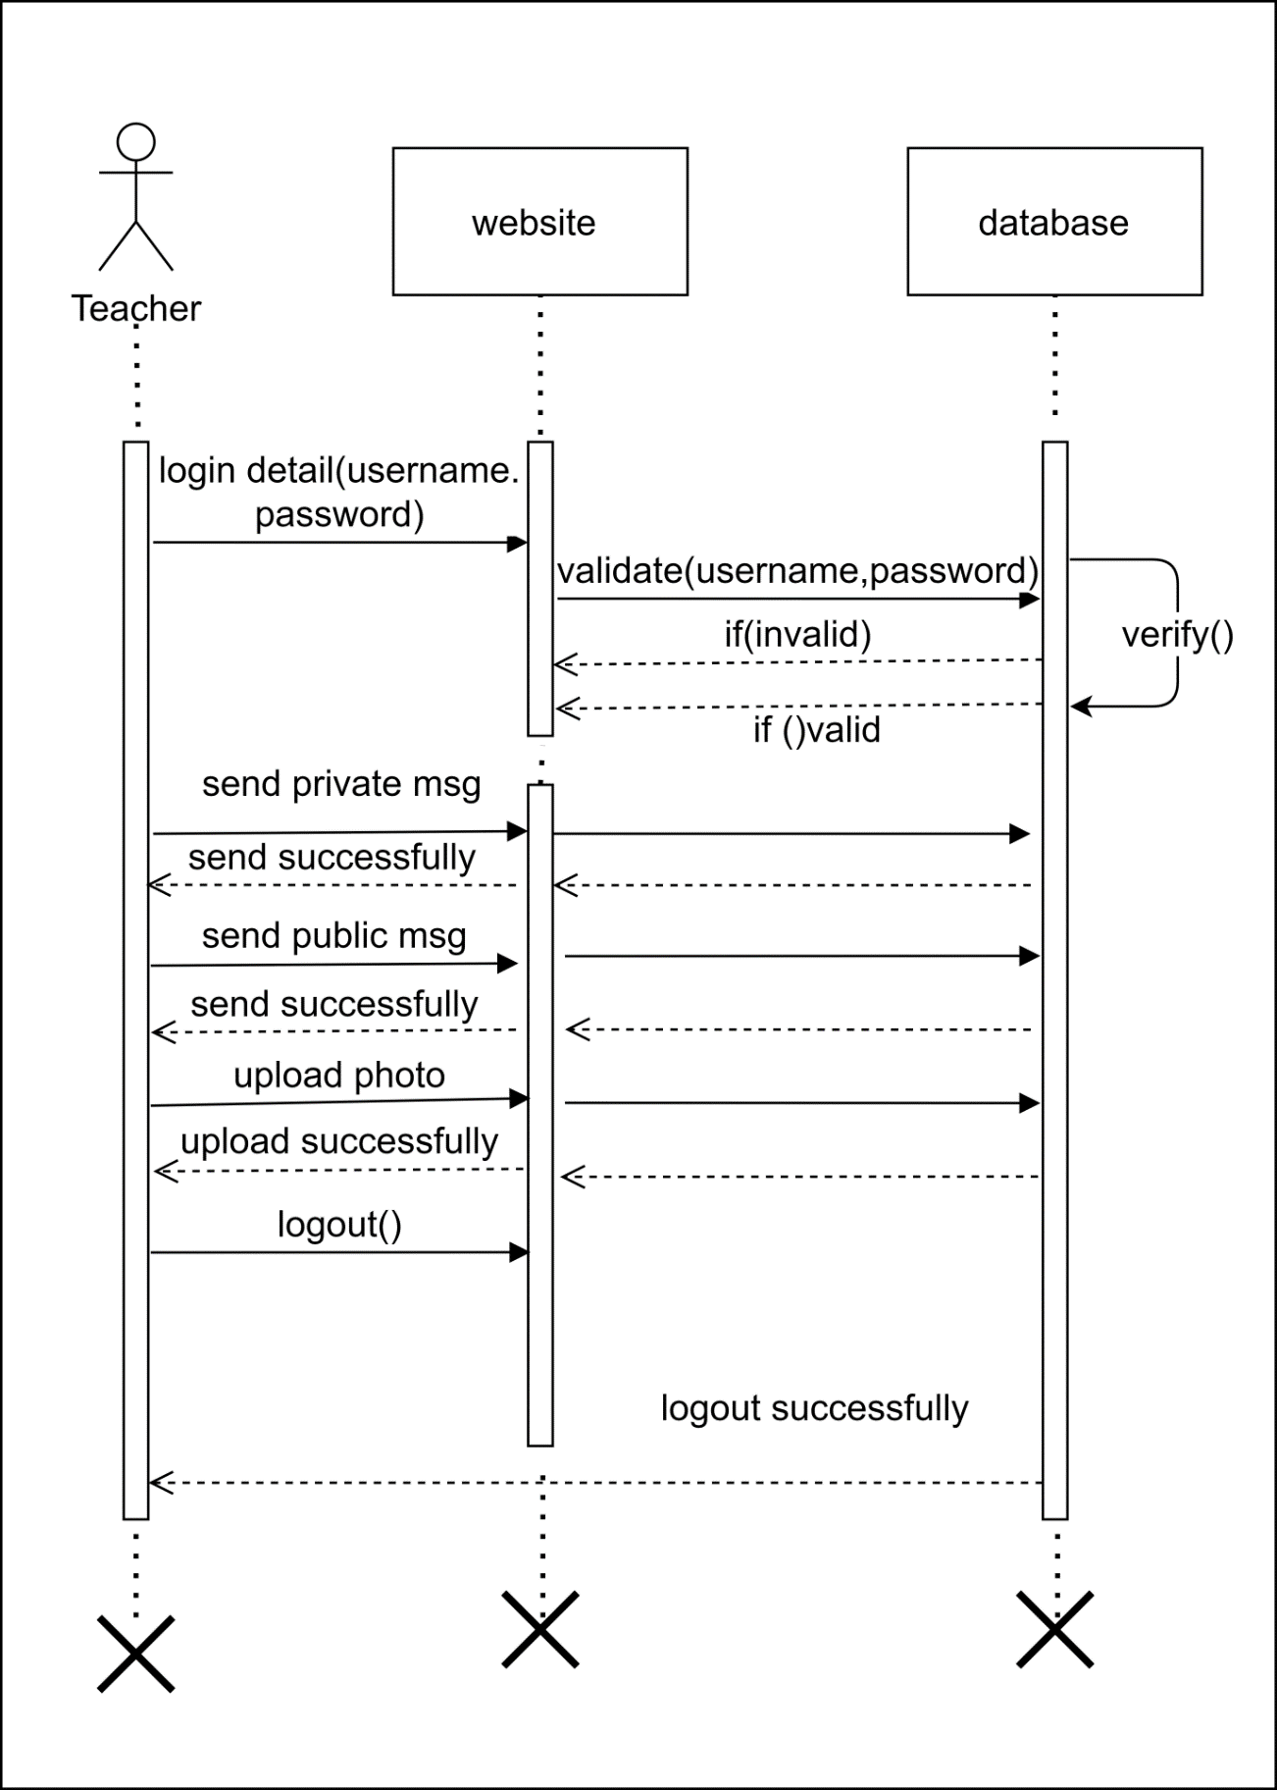
Sequence Diagram

Slide 20
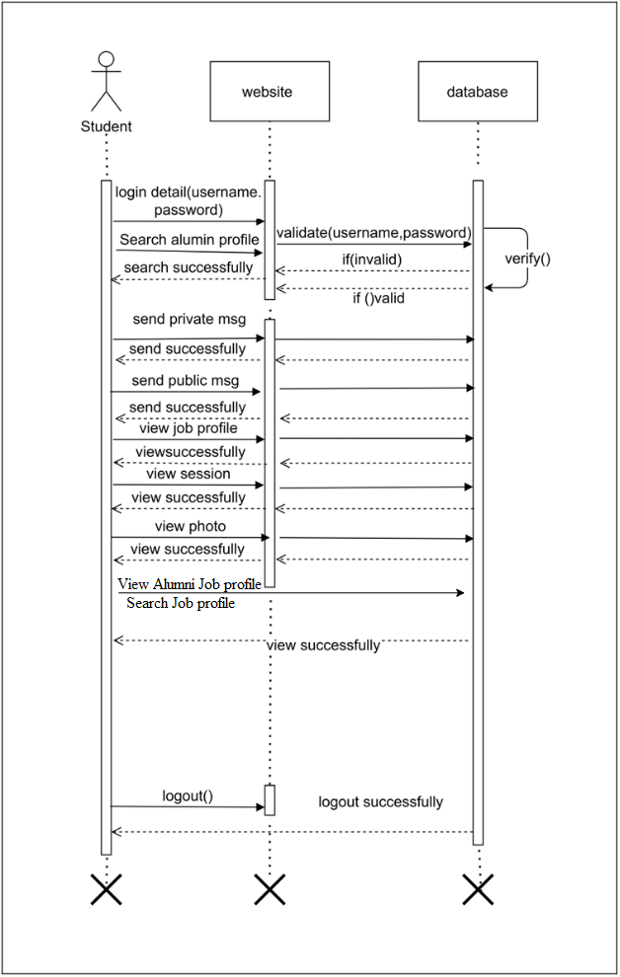

Slide 21
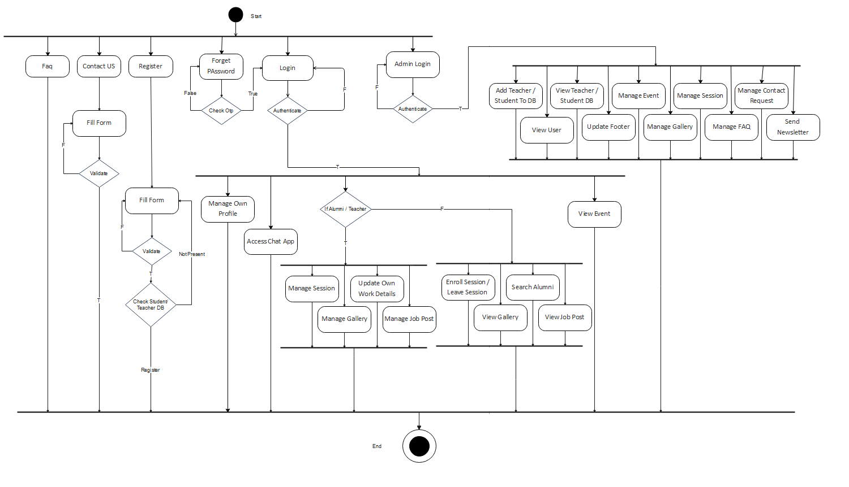
Activity Diagram

Slide 22
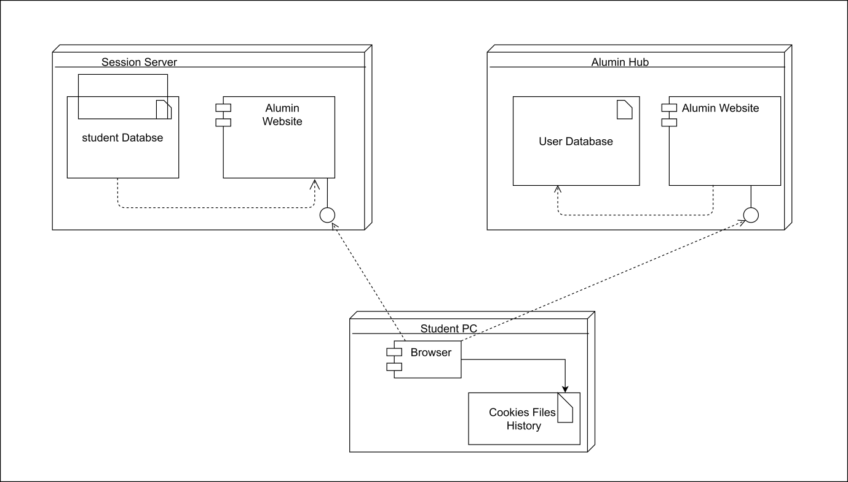
Deployment Diagram

Slide 23
Data Dictionary
Table Structure For adminrecord :
Table structure for table communication_details:
Column | Data Type | Nullability | Primary Key | Foreign Key | Notes
username | varchar(30) | NULL | YES | NO | The username of the admin user.
password | varchar(30) | NULL | NO | NO | The password of the admin user.
Column | Data Type | Nullability | Primary Key | Foreign Key | Notes
id | int(11) | NOT NULL | YES | NO | The ID of the communication record.
from_id | varchar(30) | NULL | NO | NO | The ID of the sender of the communication.
to_id | varchar(30) | NULL | NO | NO | The ID of the recipient of the communication.
msg_content | text | NULL | NO | NO | The content of the communication.
msg_date_time | varchar(30) | NULL | NO | NO | The date and time of the communication.
msg_type | varchar(30) | NULL | NO | NO | The type of the communication.

Slide 24
Table structure for table contactus:
Table structure for table event_details:
Column | Data Type | Nullability | Primary Key | Foreign Key | Notes
id | int(11) | NOT NULL | YES | NO | The ID of the contact record.
name | varchar(200) | NULL | NO | NO | The name of the person who contacted us.
email | varchar(200) | NULL | NO | NO | The email address of the person who contacted us.
subject | varchar(200) | NULL | NO | NO | The subject of the contact message.
message | varchar(300) | NULL | NO | NO | The message of the contact message.
Column | Data Type | Nullability | Primary Key | Foreign Key | Notes
id | int(11) | NOT NULL | YES | NO | The ID of the event record.
title | varchar(100) | NULL | NO | NO | The title of the event.
event_details | text | NULL | NO | NO | The details of the event.
pic_name | varchar(30) | NULL | NO | NO | The name of the image associated with the event.
upload_by_id | varchar(30) | NULL | NO | NO | The ID of the user who uploaded the event.
upload_by | varchar(45) | DEFAULT 'NA' | NO | NO | The name of the user who uploaded the event.
archive | tinyint(4) | DEFAULT '0' | NO | NO | Indicates whether the event is archived.

Slide 25
Table structure for table footer:
Column | Data Type | Nullability | Primary Key | Foreign Key | Notes
id | int(11) | NOT NULL | YES | NO | The ID of the footer record.
contact | varchar(45) | DEFAULT NULL | NO | NO | The contact information for the website.
email | varchar(45) | DEFAULT NULL | NO | NO | The email address for the website.
address | varchar(45) | DEFAULT NULL | NO | NO | The address of the website.
map_link | varchar(45) | DEFAULT NULL | NO | NO | The link to the website's map.
twitter | varchar(45) | DEFAULT NULL | NO | NO | The Twitter handle for the website.
facebook | varchar(45) | DEFAULT NULL | NO | NO | The Facebook page for the website.
instagram | varchar(45) | DEFAULT NULL | NO | NO | The Instagram handle for the website.
github | varchar(45) | DEFAULT NULL | NO | NO | The GitHub handle for the website.
website | varchar(45) | DEFAULT NULL | NO | NO | The website's URL.

Slide 26
Table structure for table faq:
Table structure for table gallery:
Column | Data Type | Nullability | Primary Key | Foreign Key | Notes
id | int(11) | NOT NULL | YES | NO | The ID of the FAQ record.
question | varchar(100) | NULL | NO | NO | The question in the FAQ.
answer | varchar(400) | NULL | NO | NO | The answer to the FAQ question.
date | varchar(45) | DEFAULT NULL | NO | NO | The date the FAQ was created.
Column | Data Type | Nullability | Primary Key | Foreign Key | Notes
id | int(11) | NOT NULL | YES | NO | The ID of the gallery record.
title | varchar(45) | DEFAULT NULL | NO | NO | The title of the gallery.
details | varchar(100) | DEFAULT NULL | NO | NO | The details of the gallery.
pic_name | varchar(45) | DEFAULT NULL | NO | NO | The name of the image in the gallery.
upload_by_id | varchar(45) | DEFAULT '0' | NO | NO | The ID of the user who uploaded the image.
upload_by | varchar(45) | DEFAULT 'NA' | NO | NO | The name of the user who uploaded the image.
archive | varchar(45) | DEFAULT '0' | NO | NO | Indicates whether the gallery is archived.
date | varchar(45) | DEFAULT NULL | NO | NO | The date the gallery was created.

Slide 27
Table structure for table job_details (job post’s details):
Table structure for table session_join_list:
Column | Data Type | Nullability | Primary Key | Foreign Key | Notes
id | int(11) | NOT NULL | YES | NO | The ID of the job details record.
designation | varchar(100) | DEFAULT NULL | NO | NO | The designation of the job.
requirments | varchar(1000) | DEFAULT NULL | NO | NO | The requirements for the job.
company_name | varchar(100) | DEFAULT NULL | NO | NO | The name of the company.
salary | varchar(30) | DEFAULT NULL | NO | NO | The salary for the job.
email | varchar(30) | DEFAULT NULL | NO | NO | The email address for the job.
add_by_id | varchar(30) | DEFAULT NULL | NO | NO | The ID of the user who added the job.
date | varchar(45) | DEFAULT NULL | NO | NO | The date the job was added.
jd | varchar(150) | DEFAULT NULL | NO | NO | The job description.
Column | Data Type | Nullability | Primary Key | Foreign Key | Notes
id | int(11) | NOT NULL | YES | NO | The ID of the session join list record.
session_id | int(11) | DEFAULT NULL | NO | YES | The ID of the session.
student_id | int(11) | DEFAULT NULL | NO | YES | The ID of the student who joined the session.

Slide 28
Table structure for table profile_details (work detail’s):
Column | Data Type | Nullability | Primary Key | Foreign Key | Notes
id | int(11) | NOT NULL | YES | NO | The ID of the profile details record.
u_id | varchar(30) | DEFAULT NULL | NO | NO | The ID of the user.
org_name | varchar(100) | DEFAULT NULL | NO | NO | The name of the organization.
org_city | varchar(100) | DEFAULT NULL | NO | NO | The city of the organization.
designation | varchar(100) | DEFAULT NULL | NO | NO | The designation of the user in the organization.
org_j_date | varchar(30) | DEFAULT NULL | NO | NO | The start date of the user's employment in the organization.
org_e_date | varchar(30) | DEFAULT NULL | NO | NO | The end date of the user's employment in the organization.
current_org | varchar(30) | DEFAULT NULL | NO | NO | Whether the user is currently employed in the organization.
job_detail | varchar(100) | DEFAULT 'NA' | NO | NO | A brief description of the user's job.

Slide 29
Table structure for table sessions_details :
Column | Data Type | Nullability | Primary Key | Foreign Key | Notes
id | int(11) | NOT NULL | YES | NO | The ID of the session details record.
session_types | varchar(100) | DEFAULT NULL | NO | NO | The type of session.
session_details | text | NULL | NO | NO | The details of the session.
session_d_t | varchar(30) | DEFAULT NULL | NO | NO | The date and time of the session.
session_arrange_by | varchar(30) | DEFAULT NULL | NO | NO | The name of the person who arranged the session.
session_arrange_id | int(11) | DEFAULT '0' | NO | NO | The ID of the person who arranged the session.
session_link | varchar(255) | DEFAULT 'NA' | NO | NO | The link to the session.
Table structure for table teacher_db:
Column | Data Type | Nullability | Primary Key | Notes
t_id | int(11) | NOT NULL | YES | The ID of the teacher record.
t_fname | varchar(45) | DEFAULT NULL | NO | The first name of the teacher.
t_lname | varchar(45) | DEFAULT NULL | NO | The last name of the teacher.
t_email | varchar(45) | DEFAULT NULL | NO | The email address of the teacher.
t_mobile | varchar(45) | DEFAULT NULL | NO | The mobile number of the teacher.

Slide 30
Table structure for table user_details:
Column | Data Type | Nullability | Primary Key | Foreign Key
id | int(11) | NOT NULL | YES | NO
user_type | varchar(30) | DEFAULT NULL | NO | The type of user (student, teacher, admin, etc.).
fname | varchar(30) | DEFAULT NULL | NO | The first name of the user.
lname | varchar(30) | DEFAULT NULL | NO | The last name of the user.
mobile | varchar(30) | DEFAULT NULL | NO | The mobile number of the user.
email | varchar(30) | DEFAULT NULL | NO | The email address of the user.
dob | varchar(30) | DEFAULT NULL | NO | The date of birth of the user.
gender | varchar(30) | DEFAULT NULL | NO | The gender of the user.
pwd | varchar(50) | DEFAULT NULL | NO | The password of the user.
instagram | varchar(100) | DEFAULT 'NA' | NO | The Instagram handle of the user.
facebook | varchar(100) | DEFAULT 'NA' | NO | The Facebook handle of the user.
twitter | varchar(100) | DEFAULT 'NA' | NO | The Twitter handle of the user.
git | varchar(100) | DEFAULT 'NA' | NO | The GitHub handle of the user.
address | varchar(100) | DEFAULT 'NA' | NO | The address of the user.
profession | varchar(50) | DEFAULT 'NA' | NO | The profession of the user.
skill | varchar(100) | DEFAULT 'NA' | NO | The skills of the user.
website | varchar(100) | DEFAULT 'NA' | NO | The website of the user.
photo | varchar(100) | DEFAULT 'NA' | NO | The photo of the user.
bio | varchar(200) | DEFAULT 'Add bio' | NO | The bio of the user.

Slide 31
Table structure for table student_db:
Column | Data Type | Nullability | Primary Key | Notes
s_id | int(11) | NOT NULL | YES | The ID of the student record.
s_fname | varchar(70) | DEFAULT NULL | NO | The first name of the student.
s_lname | varchar(70) | DEFAULT NULL | NO | The last name of the student.
s_email | varchar(45) | DEFAULT NULL | NO | The email address of the student.
s_batch | varchar(45) | DEFAULT NULL | NO | The batch of the student.
s_div | varchar(45) | DEFAULT 'NA' | NO | The division of the student.
s_mobile | varchar(45) | DEFAULT NULL | NO | The mobile number of the student.

